Slide 1
Chapter 12: Indexing and Hashing
Basic Concepts
Ordered Indices
B+Tree Index Files
B-Tree Index Files
Static Hashing
Dynamic Hashing
Multiple-Key Access

Slide 2
Basic Concepts
  Many queries references small number of records in file. Eg “Find all accounts at Perryridge branch”.
  Inefficient to read each record and check value of branch-name.
  Indexing mechanisms used to speed up access to desired data.
    E.g., index in book, author catalog in library
  Database system will look index to find on which disk block corresponding record resides and fetch the disk block to get the record

Slide 3
  Search Key - attribute to set of attributes used to look up records in a file.
  An index file consists of records (called index entries) of the form (search key, pointer). Pointer has identifier of disk block and an offset within disk block to identify record within block.
  Index files are typically much smaller than the original file

Slide 4
Index Evaluation Metrics
Two basic kinds of indices:
  Ordered indices: search keys are stored in sorted order
  Hash indices: search keys are distributed uniformly across “buckets” using hash function
Factors on which techniques will be evaluated:
  Access types supported efficiently. E.g.,
  finding particular attribute values or in range values
  Access time : The time it takes to find a particular data item
  Insertion time : Time taken for insert data
  Deletion time : Time taken for delete data
  Space overhead : : The additional space occupied by an index structure.

Slide 5
  We often want to have more than one index for a file.
  For example, libraries maintained several card catalogs: for author, for subject, and for title.
  An attribute or set of attributes used to look up records in a file is called a search key.

Slide 6
Ordered Indices
  To gain fast random access to records in a file, we can use an index structure
  Each index entry is associated with particular search key
  An ordered index, stores value of search key in sorted order and associates with each search key records that contain it.
  Primary index: in a sequentially ordered file, the index whose search key specifies the sequential order of the file.
    Primary indix is also called clustering index
    The search key of a primary index is usually but not necessarily the primary key.
  Index-sequential file: ordered sequential file with a primary index on search key.

Slide 7
    Secondary index: an index whose search key specifies an order different from the sequential order of the file. Also called non-clustering index.

Slide 8
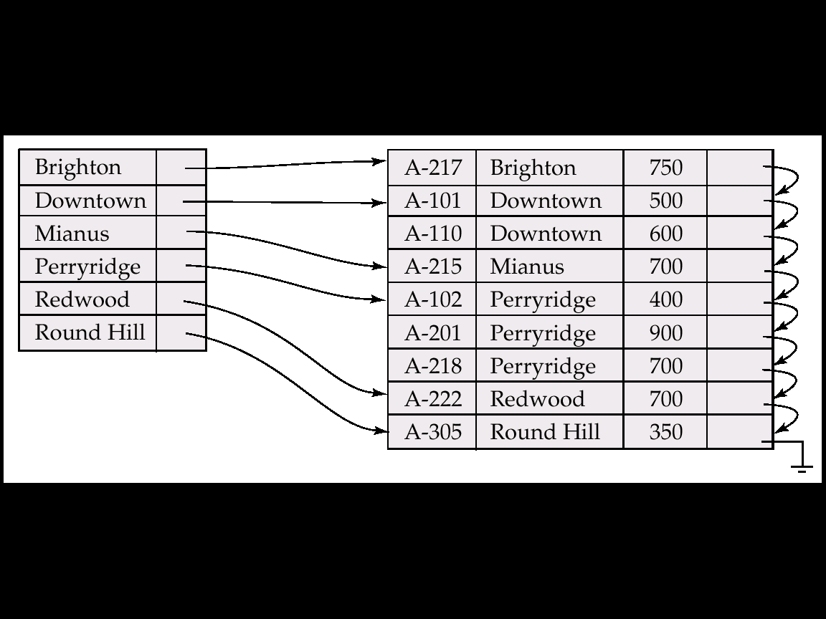
Ordered Indices (Contd…)
Primary index : , the records are stored in search-key order,
with branch-name used as the search key.

Slide 9
Dense Index Files
  Dense index — Index record appears for every search-key value in the file.
  In dense primary index, records are sorted on same search key.
  Index record contains search key value and pointer to first data record with search key value
  Rest of records are stored sequentially
  .

Slide 10
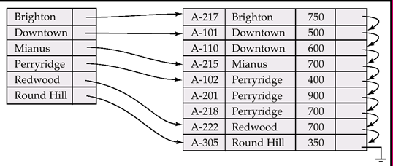
  Suppose that we are looking up records for the Perryridge branch. Using the dense index of Figure we follow the pointer directly to the first Perryridge record.
  continue processing records until we encounter a record for a branch other than Perryridge

Slide 11
Sparse Index File
  Sparse Index: contains index records for only some search-key values.
    Applicable when records are sequentially ordered on search-key
  To locate record, find index entry with largest search key value that is less than or equal to search key value we are looking and then search file sequentially.

Slide 12
  For e.g finding a entry for Perryridge branch in
  Given sparse index file.entry for perrryridge branch is not available in sparse index file.
  Since the last entry (in alphabetic order) before “Perryridge” is “Mianus,” , follow that pointer.
  Then read the account file in sequential order until we find the first Perryridge record

Slide 13
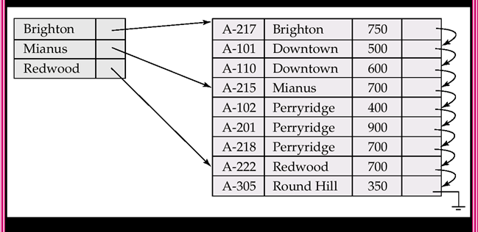
Sparse index file for account table/file

Slide 14
Dense V/S Sparse Index
  Dense Index: Faster to locate records but occupy more space Sparse Index: Less space required but not faster
  System designer must make trade off between space and access time
  Good tradeoff: sparse index with an index entry for every block in file. We can locate block containing record that we are looking
  Cost to process a database request is time to bring block from disk to memory.
  Once block is in memory, time required to scan entire block is negligible.

Slide 15
Multilevel Index
  Suppose file has 100,000 records and 10 records in each block ie 10,000 blocks.
  If one index record per block then index will have 10,000 records.
  Assume that 100 index records fit in 1 block then index file itself will need 100 blocks. Such large index files must be stored on disk.
  To locate a record, binary search is used on index file to locate entry but still it has large cost.
    If index occupies b blocks, binary search requires log₂(b) blocks to read
    E.g if 100 index blocks, binary search will require 7 blocks read will be required to read single record, which is very time consuming

Slide 16
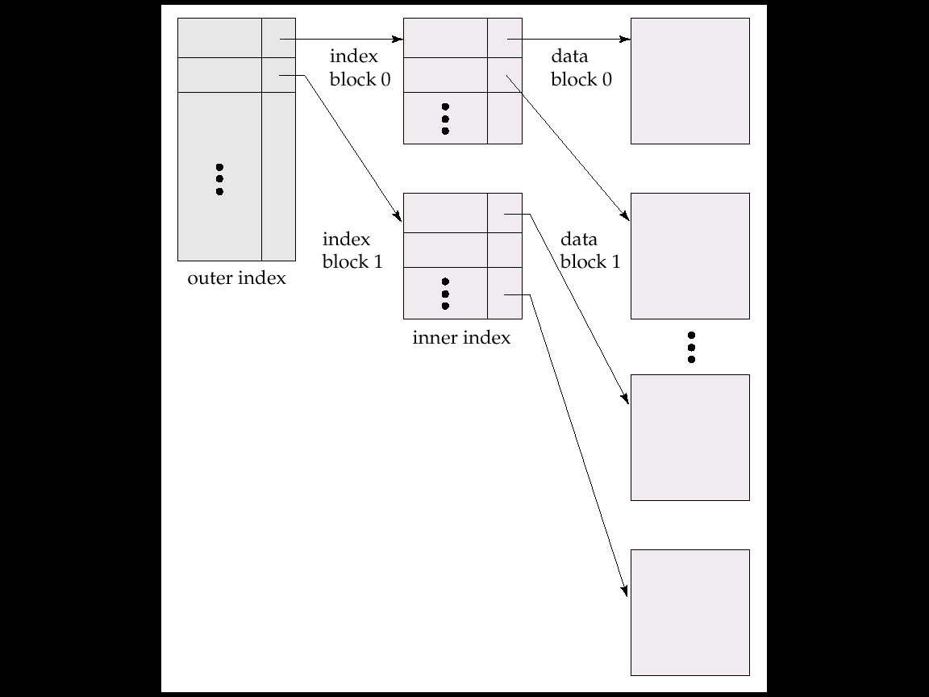
Multilevel Index
  To deal with this problem,
  Treat index file as any other sequential file and construct sparse index on primary index.
  To locate record, first use binary search on outer index to find record for largest search key value. Pointer points to block of inner index.
  Pointer in inner record points to block of file containing record.

Slide 17
Sfds

Slide 18
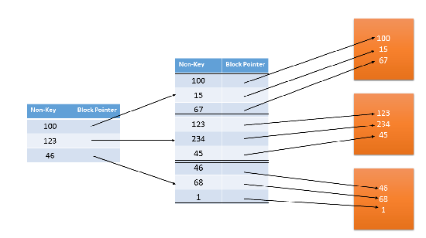

Slide 19
Multilevel Index
  If our file is extremely large even though outer index may grow too large to fit in memory we can create another level of index.
  Indices with two or more levels are called as multi level indices.
  Searching of record with multilevel index requires significantly fewer IO operations.

Slide 20
Index Update: Deletion
  If deleted record was the only record in the file with its particular search-key value, the search-key is deleted from the index also.
  Single-level index deletion:
  Dense indices – deletion of search-key is similar to file record deletion.
  Sparse indices – if an entry for the search key exists in the index, it is deleted by replacing the entry in the index with the next search-key value in the file (in search-key order). If the next search-key value already has an index entry, the entry is deleted instead of being replaced.

Slide 21
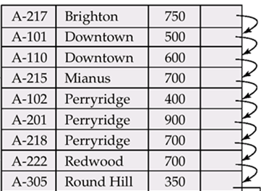
Deletion on sparse index
Downtown
Perryridge
Redwood
xyz
Downtown
Redwood

Slide 22
Index Update: Insertion
Single-level index insertion:
  Perform a lookup using the search-key value appearing in the record to be inserted.
  Dense indices – if the search-key value does not appear in the index, insert it.
  Sparse indices – if index stores an entry for each block of the file, no change needs to be made to the index unless a new block is created. In this case, the first search-key value appearing in the new block is inserted into the index.
  Multilevel insertion (as well as deletion) algorithms are simple extensions of the single-level algorithms

Slide 23
Secondary Indices
  Secondary indices must be dense, with an index entry for every search-key value, and a pointer to every record in the file.
  if the search key of a secondary index is not a candidate key, it is
  not enough to point to just the first record with each search-key value. The remaining records with the same search-key value could be anywhere in the file
  since the records are ordered by the search key of the primary index, rather than by the search key of the secondary index. Therefore, a secondary index must contain pointers to all the records
  can use an extra level of indirection to implement secondary indices on search keys that are not candidate key

Slide 24
500
500
500
500 | B1
700 | B1
500 | B2
500 | b3

Slide 25
Secondary Indices
  Frequently, one wants to find all the records whose values in a certain field (which is not the search-key of the primary index) satisfy some condition.
    Example 1: In the account database stored sequentially by account number, we may want to find all accounts in a particular branch
    Example 2: as above, but where we want to find all accounts with a specified balance or range of balances
  We can have a secondary index with an index record for each search-key value; index record points to a bucket that contains pointers to all the actual records with that particular search-key value.

Slide 26
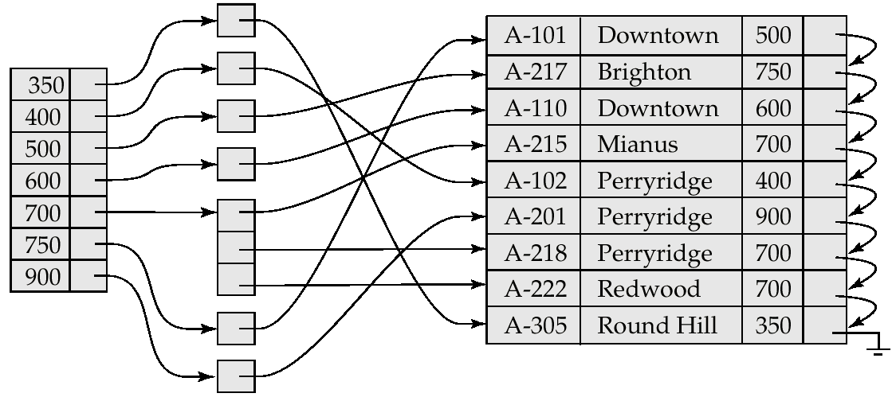
Secondary Index on balance field of account

Slide 27
Static Hashing
  In a hash file organization we obtain address of disk block containing record directly by computing hash function on search key value of record.
  A bucket is a unit of storage containing one or more records (a bucket is typically a disk block).
  Hash function h is a function from the set of all search-key values K to the set of all bucket addresses B.
  To insert a record with search key Ki compute h(Ki) then search bucket with that address hash(production) = 4- > 4th disk block /bucket
  Similarly for access as well as deletion.
  Records with different search-key values may be mapped to the same bucket; thus entire bucket has to be searched sequentially to locate a record.

Slide 28
Hash Functions
  Worst hash function maps all search-key values to the same bucket
  Ideal hash function distributes keys uniform across all buckets so that every bucket has same number of records.
  Distribution is uniform, i.e., each bucket is assigned the same number of search-key values from the set of all possible search-key values.
  Distribution is random, i.e. each bucket will have the same number of records assigned to it irrespective of the actual distribution of search-key values in the file.

Slide 29
Hash Functions (contd…)
  The hash function will not be correlated to any externally visible ordering e.g. alphabetical ordering .
  Hash function maps search key beginning with ith letter to ith bucket, assuming that there are 26 buckets. It is not uniform or random distribution as there will be more records beginning with letter B or R
  Typical hash functions perform computation on the internal binary representation of the search-key.

Slide 30
Example of Hash File Organization (Cont.)
Hash file organization of account file, using branch-name as key
  There are 10 buckets,
  The binary representation of the ith character is assumed to be the integer i.
  The hash function returns the sum of the binary representations of the characters modulo 10
  E.g. h(Perryridge) = 5 h(Round Hill) = 3 h(Brighton) = 3

Slide 31
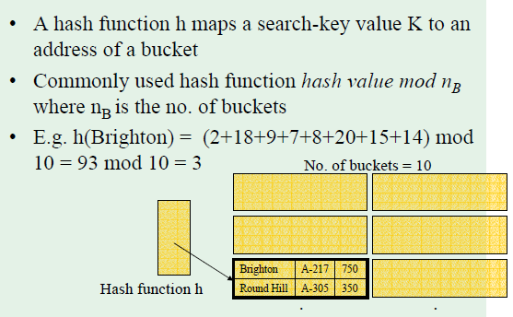

Slide 32
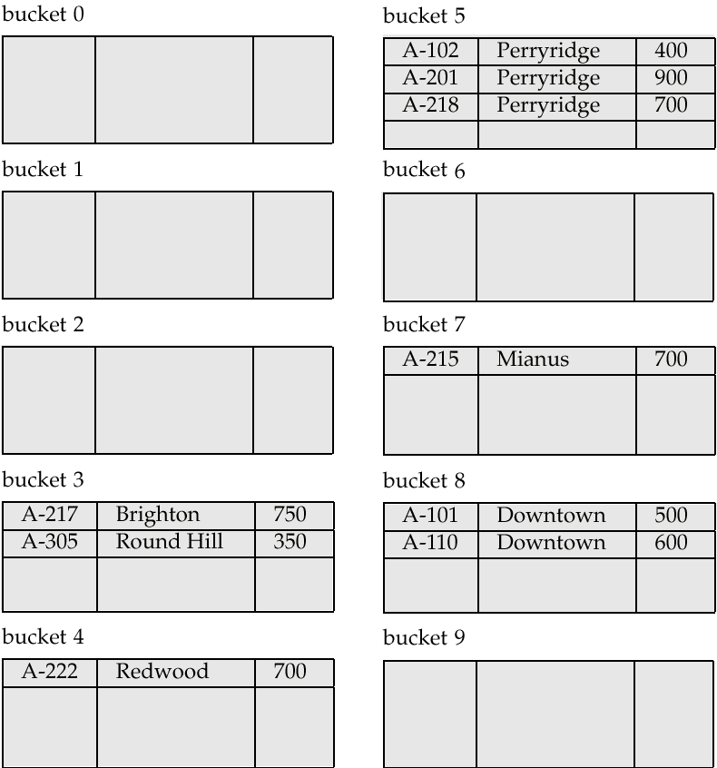
Example of Hash File Organization
Hash file organization of account file, using branch-name as key

Slide 33
Handling of Bucket Overflows
  When record is to be inserted and no space in bucket then it is said to be bucket overflow
  Bucket overflow can occur because of
    Insufficient buckets
      n_{B}=buckets, f_{r}=no. of records fit in bucket, n_{r}= total no. of records Then n_{b} > n_{r}/f_{r}
      1000 records = nr , fr=5 records in one backet . 1000/5 = 201 buckets,
      But we assume that total no. of records are known when hash function is chosen.
    Skew
      Some buckets are assigned more records then others, so bucket may get overflow even when other buckets still have space. This situation is called as skew.

Slide 34
    This can occur due to two reasons:
      multiple records have same search-key value
      chosen hash function produces non-uniform distribution of key values
  Although the probability of bucket overflow can be reduced, it cannot be eliminated; it is handled by using overflow buckets

Slide 35
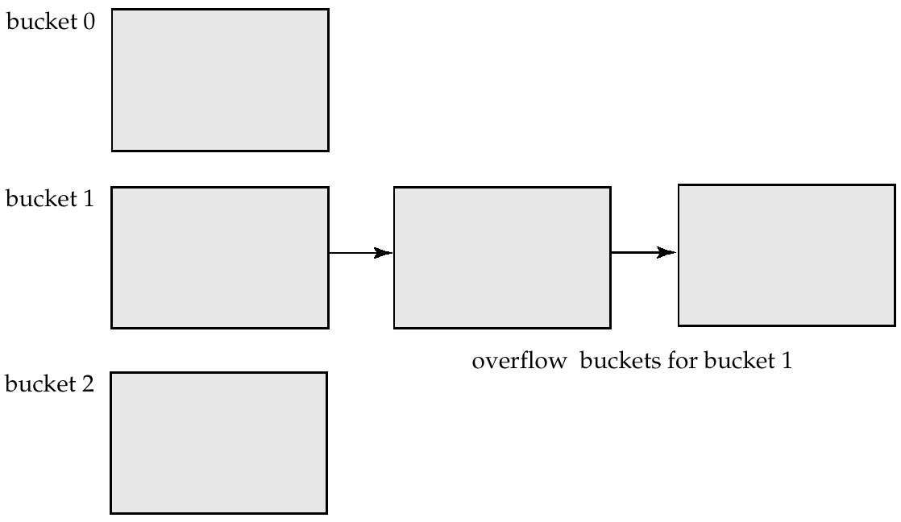
Handling of Bucket Overflows (Cont.)
  If bucket is full overflow bucket is given. If overflow bucket is full another overflow bucket is given and so on
  Overflow chaining – the overflow buckets of a given bucket are chained together in a linked list.
  All records of bucket as well as all overflow buckets must be checked. This scheme is called closed hashing.

Slide 36
Handling of Bucket Overflows (Cont.)
  An alternative is called open hashing in which there are no overflow buckets.
  If bucket is full system inserts records in some other bucket.
  One policy is to use next bucket (cyclic order) that has space. It is called as Linear Probing
  Lookup and insertion is easy but deletion is difficult to handle.
  Open hashing is used in compilers and assemblers but not suitable for database

Slide 37
Hash Indices
  Hashing can be used not only for file organization, but also for index-structure creation.
  A hash index organizes the search keys, with their associated record pointers, into a hash file structure.
  Apply hash function on search key to identify bucket and store key and its associated pointers in bucket.
  Hash indices are always secondary index.

Slide 38
  Because hash index on primary index is never needed as file is already sorted according to primary index.
  Hash index on account file for search key account number. Hash function is sum of digits of account number modulo 7. Assume that each bucket can store 2 records

Slide 39
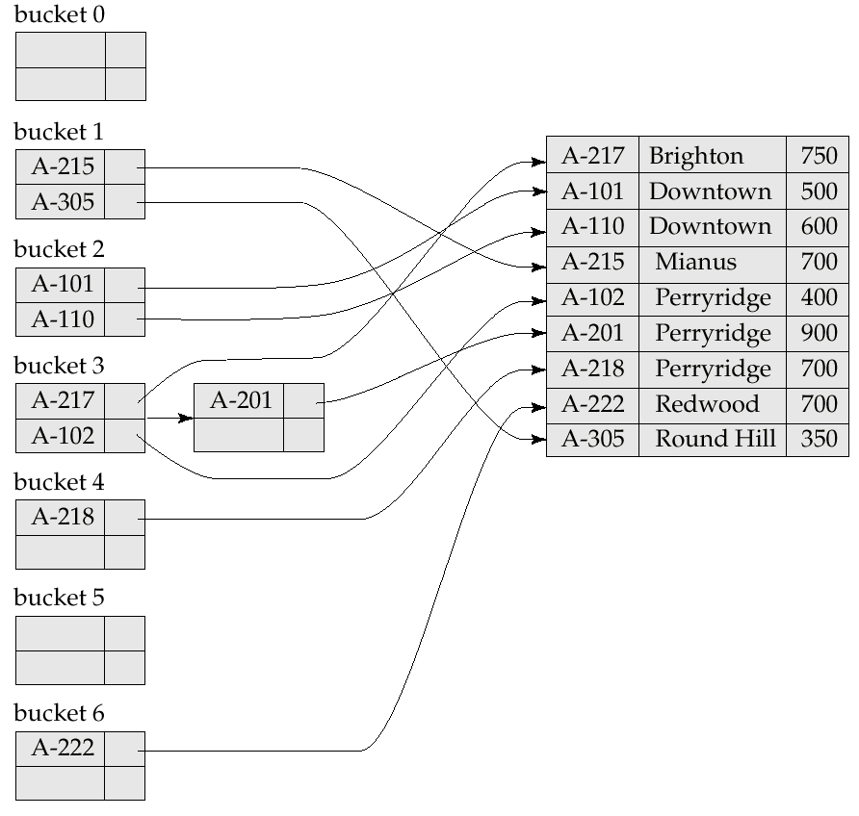
Example of Hash Index

Slide 40
Dynamic Hashing
  Allows the hash function to be modified dynamically
  Extendable hashing – one form of dynamic hashing
  Buckets grows and shrinks as database size increases or decreases
  Hash function generates values over b-bit integers, with b = 32.
  Buckets are created as and when records are inserted into file
  At any time use only i bits 0<=i<=b.
  Bucket address table size = 2^{i.} Initially i = 0
  Value of i grows and shrinks as the size of the database grows and shrinks.
  i_{j} indicates length of common hash prefix for bucket j

Slide 41
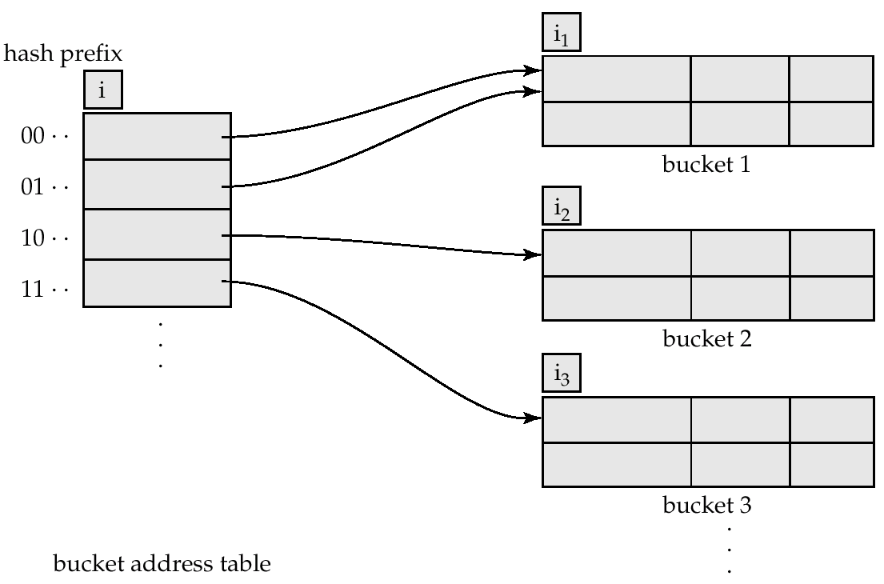
General Extendable Hash Structure

Slide 42
Use of Extendable Hash Structure
To locate the bucket containing search-key K_{j}:
  1. Compute h(K_{j}) = X
  2. Use the first i high order bits of X and follow pointer to appropriate bucket
To insert a record with search-key value K_{j}
  follow same procedure as look-up and locate the bucket, say j.
  If there is room in the bucket j insert record in the bucket.
  If bucket is full , split bucket and redistribute current records + new to be inserted

Slide 43
Updates in Extendable Hash Structure
To split a bucket j when inserting record with search-key value K_{j}:
If i = i_{j} (j)
  increment i aonly one pointer to bucket nd double the size of the bucket address table.
  replace each entry in the table by two entries that point to the same bucket.
  Allocate new bucket z and set second entry to z.
  Set i_{j} and i_{z} to i
  Rehash each record in bucket j depending on first i bits and keep record either in j or z.

Slide 44
If i > i_{j} (more than one pointer to bucket j)
  Split bucket j without increasing size of bucket address table. All entries that points to j has same value for leftmost i_{j} bits
  allocate a new bucket z, and set i_{j} and i_{z} to the old i_{j} + 1.
  Readjust pointers: Leave first half of entries pointing to bucket j and set all remaining entries point to z
  Rehash records in bucket j and allocate to j and z.
  further splitting is required if the bucket is still full

Slide 45
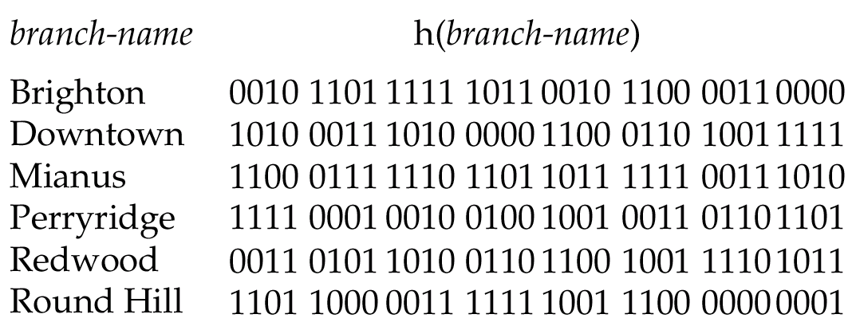
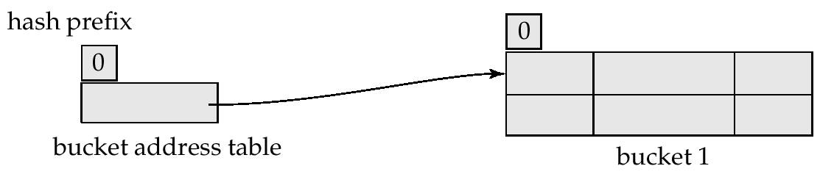
Use of Extendable Hash Structure: Example
Initial Hash structure, bucket size = 2

Slide 46
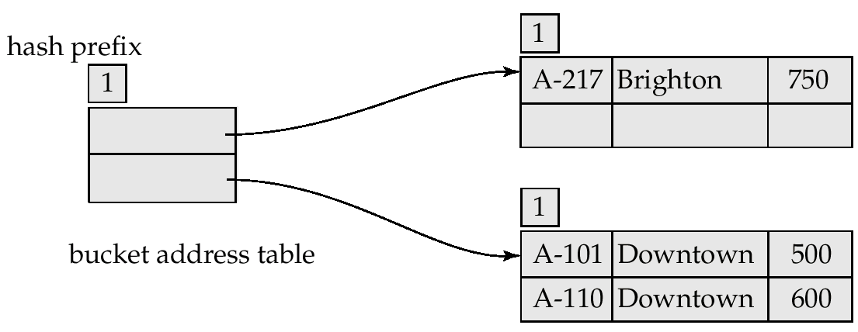
Example (Cont.)
Hash structure after insertion of one Brighton and two Downtown records
1
0
1

Slide 47
  Next, we insert (A-215, Mianus, 700). Since the first bit of h(Mianus) is 1, we must
  insert this record into the bucket pointed to by the “1” entry in the bucket address
  table. Once again, we find the bucket full and i = i1. We increase the number of bits that we use from the hash to 2
  This increase in the number of bits necessitates
  doubling the size of the bucket address table to four entries

Slide 48
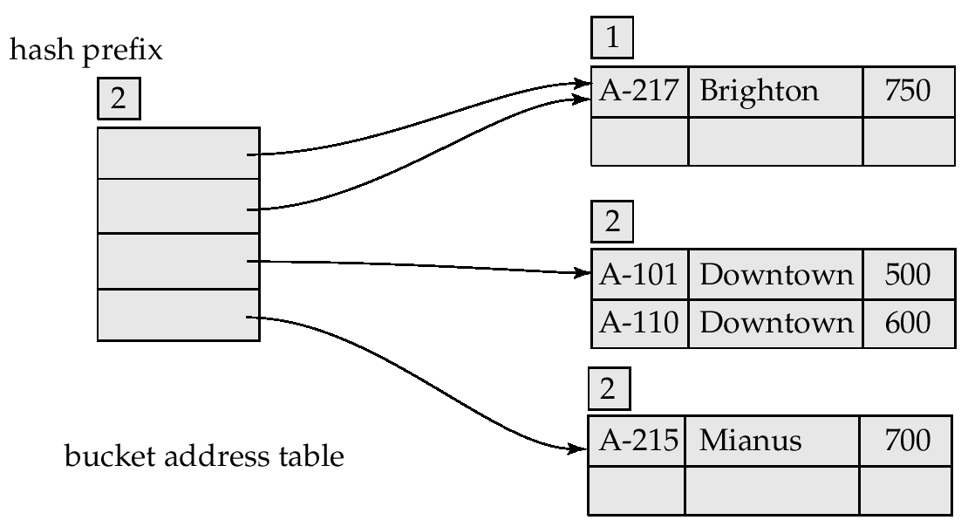
Example (Cont.)
Hash structure after insertion of Mianus record
00
01
10
11
peridge

Slide 49
  Next,we insert (A-102, Perryridge, 400), which goes in the same bucket as Mianus.
  insertion, of (A-201, Perryridge, 900), results in a bucket overflow, leading to an increase in the number of bits, and a doubling of the size of the bucket address table

Slide 50
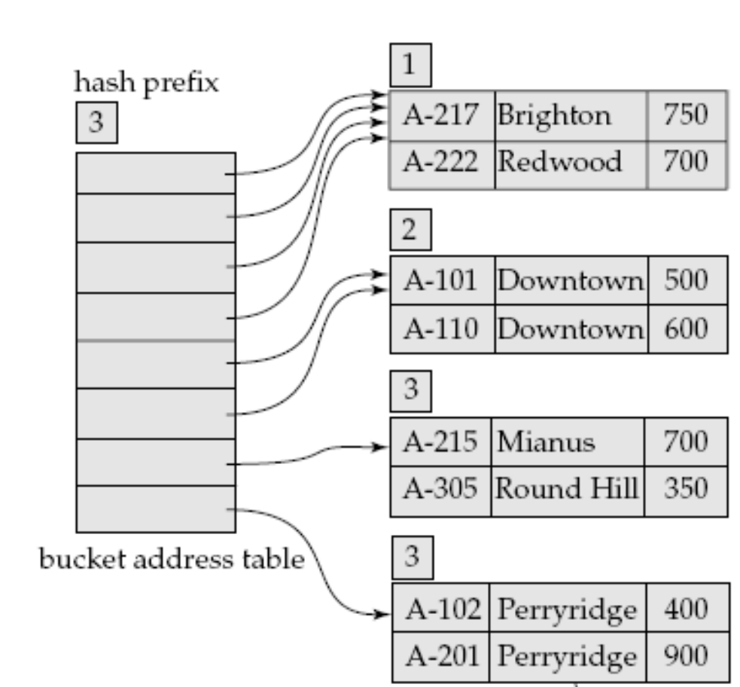
000
001
010
011
100
101
110
111

Slide 51
  The insertion of the third Perryridge record, (A-218, Perryridge, 700),
  leads to another overflow. However, this overflow cannot be handled by increasing
  the number of bits, since there are three records with exactly the same hash value.
  Hence the system uses an overflow bucket,

Slide 52
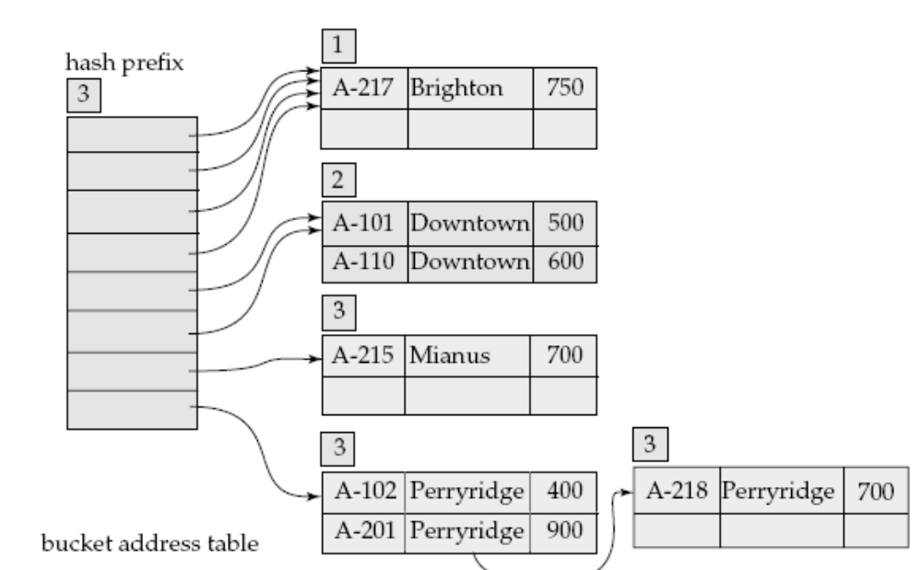

Slide 53
Advantage of dynamic/extensible hashing
  The main advantage of extendable
  hashing is that performance does not degrade as the file grows. Furthermore, there is minimal space overhead. Which is for bucket address table
Disadvantage of dynamic/extensible hashing
  disadvantage of extendable hashing is that lookup involves an additional levelof indirection, since the system must access the bucket address table before accessing the bucket itself.

Slide 54
Multiple-Key Access
  Use multiple indices for certain types of queries.
Example:
  select account-number
  from account
  where branch-name = “Perryridge” and balance = 1000
Possible strategies for processing query using indices on single attributes:
  1. Use index on branch-name to find accounts with balances of $1000; test balance=1000.
  2. Use index on balance to find accounts with balances of $1000; test branch-name = “Perryridge”.
  3

Slide 55
    Use index on branch-name to find pointers to all records pertaining to the Perryridge branch. Similarly use index on balance and find record wit balance value $1000.
    Take intersection of both sets of pointers obtained.
    • There are many records pertaining to the Perryridge branch.
    • There are many records pertaining to accounts with a balance of $1000.
    • There are only a few records pertaining to both the Perryridge branch and accounts with a balance of $1000.
    If these conditions hold, we must scan a large number of pointers to produce a small result.

Slide 56
Grid File
  Grid file is other alternative of multiple access key.
  A grid structure for queries on two search keys is a 2-dimensional grid, or array, indexed by values for the search keys.
  If we want to access a file on two keys, say Dno and Age as in our example, we can construct a grid array with one linear scale (or dimension) for each of the search attributes.
  grid array for the EMPLOYEE file with one linear scale for Dno and another for the Age attribute.
  Dno identify the row and age is search key value is used to find column so that each cell corresponding to bucket address.

Slide 57
Dept =2 and age=25
sfsdfs

Slide 58
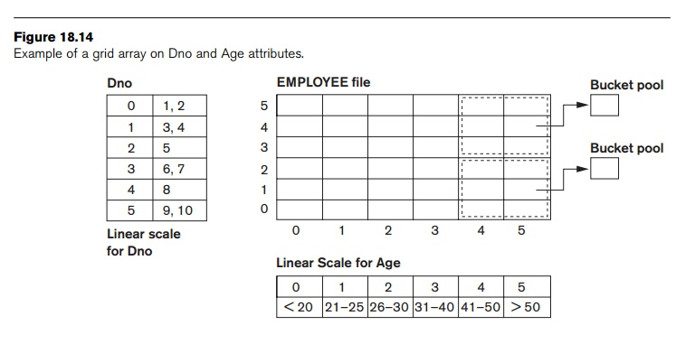
  our request for Dno = 4 and Age = 59 maps into the cell (1, 5) corresponding to the grid array
  The records for this combination will be found in the correspond-ing bucket.

Slide 59
End of Chapter

